Slide 1
The Wild Card Book Study
Bailey Station Elementary
In-service August 2018
Miranda Manley, Asst. Principal

Slide 4
What is your why?

Slide 5
When you step into the classroom, your Why Becomes their why, so you should be clear about what you’re offering to them. Our wHY is not about what our students think of us!

Slide 6
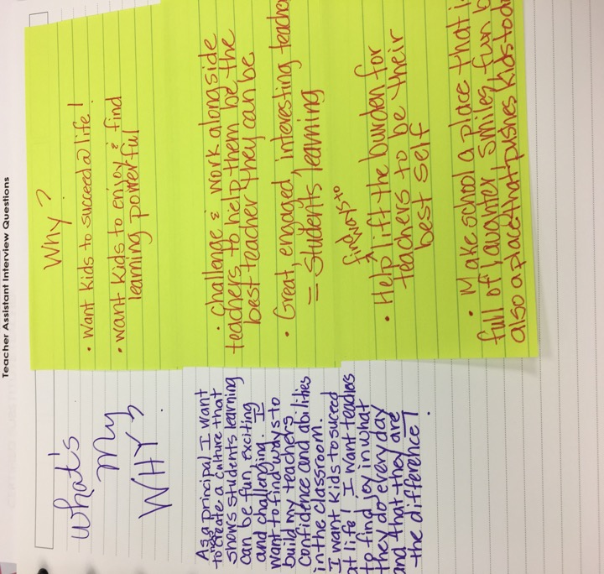

Slide 8
The Wild Card is a metaphor for what YOU bring to the classroom, You are ”The Wild Card”!

Slide 9
Creativity

Slide 10
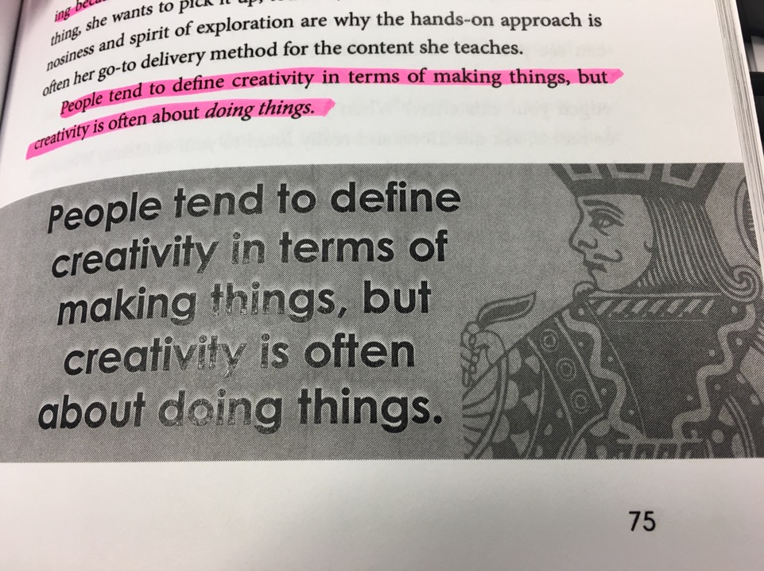

Slide 11
Do your students want to be in your classroom, or do they merely have to be there?

Slide 12
Reflection

Slide 13
You should jump on any opportunity to build relationships and get a little bit nosy about your students’ lives and interests- both are key elements in your creative breakthrough.
Look for one thing to do differently!
How do you feel about this statement from the book?
”Too many teachers spend their lunch period or recess with other teachers making small talk, gossiping, and let’s be honest – complaining about how their day is going. Pull yourself out of that unproductive routine! Sit with a different group of students every day. Or eat your lunch quickly and then walk around, pulling up a chair to different tables for a few minutes. If you’re teaching the younger kids, go out to the playground with them and swing or climb on the monkey bars. The impact it can have is huge, and yet it’s a rare event. This is the perfect way to create the unexpected and ensure all eyes are on you.”
“Building relationships with your students can translate into academic success because children want to try harder for you when they can see you care about them.”

Slide 14
How can you self-reflect about the changes you might want to make in your classroom?
Video yourself teaching – Would you want to be in this class all day?
Take a look at your personality
Will you make excuses that you can’t be creative because “math is not a creative subject”, “your
students get off task easily”, ”you have some real big behavior issues in your class”, etc.
4. Take a look at your classroom culture in terms of respect, manners, tolerance, acceptance of
differences, and the way students interact with one another. Do you create opportunities for them
to learn about one another and collaborate in positive ways? Do you model what positive interactions
look like?
Reflect on your classroom management strategies. Do you have good control of your kids, or will
you need to work on that before you can give them autonomy to do hands-on learning, etc.?
Will you say that your class is too large to be creative?
Will student socioeconomic status be an excuse for low engagement?
Look at your own mindset. Did you move forward into a growth mindset? Do you still have pockets
or obstacles that trigger you back into a fixed mindset?

Slide 15
Reflect on your goals
Thinking about your priorities can help you determine your path, your pace, and your purpose.
When you reflect on your goals, remember this: Ultimately, results are what matter. Whatever
Methods you use, the reality is that you have to get to a point where you can prove they are
Working. There is a good reason administrators regard games or room transformations as fluff.
It becomes fluff when the environment is not paired with rigorous content.
Examine your attitudes about standardized testing. Teachers complain about testing and say
They spend too much time preparing students for tests. The reality is that, in every profession,
People have to demonstrate their effectiveness. In our profession, results are measured through
Standardized testing. It is unlikely it will go away so we need to find a way to come to terms with
This reality rather than complain about it.
Content is what you are selling, but it’s the delivery (your creative approach) that determines
Whether or not your students are buying.

Slide 16
Engagement
Good teaching is ¼ preparation and ¾ theater.
–Gail Godwin, novelist

Slide 17
Rule #1 Go for application instead of memorization.
Allow students to apply what they have learned through hands-on, higher-level thinking activities.

Slide 18
Rule #2 No student becomes invisible; everyone is accountable. What is the problem with playing jeopardy to study for a test? All means all!

Slide 19
4 Essential ingredients of engagement
• Expectations
-You must lay a strong foundation by setting your expectations for your students’ behavior. It is not enough to set rules; you must enforce them consistently. Ex. Call & Response
• Environment
-Engagement happens when you establish an environment that is relevant to your students, reflects their interests and yours, promotes learning, and is both visually and emotionally appealing. Ex. Musical theme
• Energy
-Engagement calls for energy. You want your mood and the way you greet your students to communicate that what you have to offer today is an electrifying learning experience. Ex. Class song or dance
•Empowerment
-You can empower students in two ways.
1. By building strong relationships with them and fostering relationships with one another.
2. Through instructional strategies that give them ownership of learning. Ex. Class cheers

Slide 20
Leave your students wondering what you’ll do next so they’ll be eager to show up again tomorrow. Predictable will never be magical!

Slide 21
authenticity

Slide 22
What is your go to thing? What is something that you enjoy that is outside of the school?

Slide 23
grit

Slide 24
An excuse is a defense mechanism. It’s a justification for giving up. It’s a falsehood the Joker plants in your mind to make you believe you can’t do something. The magic only happens when you shift into no-excuses mode and focus on the path in front of you – roadblocks and all.

Slide 25
If you find yourself saying things like, “oh, those low test scores are just because of this group of kids I have this year,” it’s probably time to go back and really reflect on your teaching that year. Were you giving 100 percent? Were your students giving 100 percent?

Slide 26
You can’t go back and change your past, and in many cases, you can’t change your innate personality traits. It is not about being perfect, but about how you deal with your imperfections. It’s about how you handle those internal struggles and those external roadblocks.

Slide 27
Jealousy is a mask for fear When you feel jealous of another teacher, ask yourself if it’s because you see that person doing something you’re not brave enough to attempt. Remember that you have a different path, one that is authentic to you. Then Summon up your grit and try something new!

Slide 28
persistence

Slide 29
If you ever start to feel comfortable, it’s a sign you’ve stopped growing!

Slide 30
Lift up your colleagues! It takes a village and the larger you can make your village, the more magic you can create!

Slide 31
As you start the new year remember: Smile act on your passion show your enthusiasm consistently with your colleagues as well as your students!

